Slide 1



Submitted By:
Aryan Gupta (201500150)
Yash Sharma (201500825)
Harsh Agarwal (201500263)
Vutukuri Amaresh (201500808)
Javvaji Vinay Venkat Sandeep(201500314)

Slide 2
Travelling Website
Travel is the movement of people between distant Geographical locations. Travel can be done by foot, bicycle, automobile, train, boat, bus, ship and other means, with or without luggage and can be one way or round trip. Travel can also include relatively short stays between successive movements, as in the case of tourism.

Slide 3
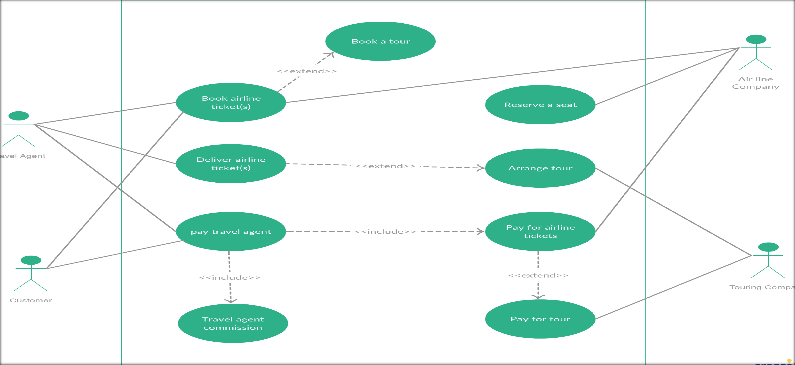

Slide 4
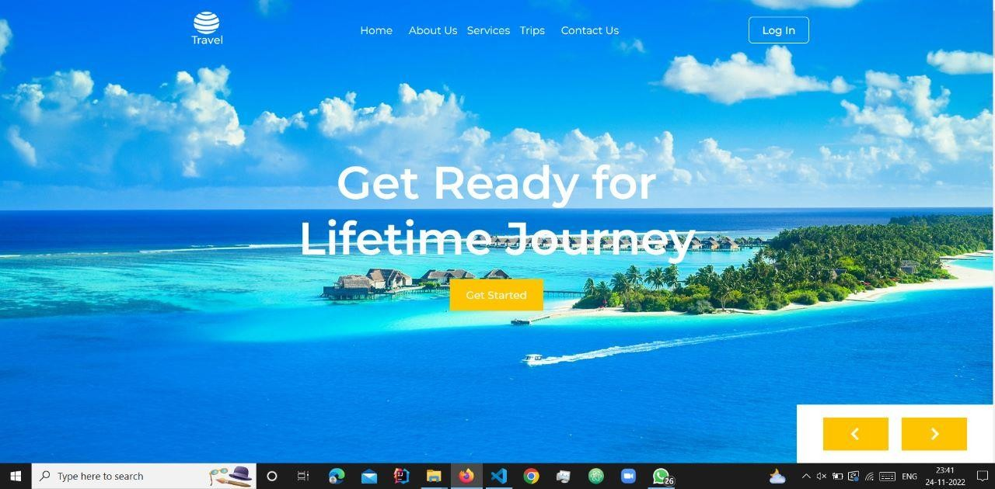
HOME PAGE

Slide 5



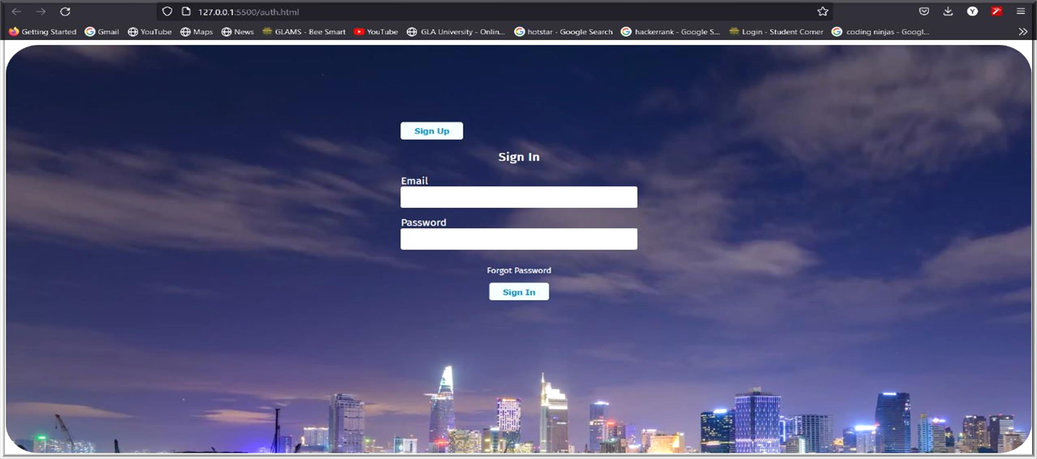

Slide 6

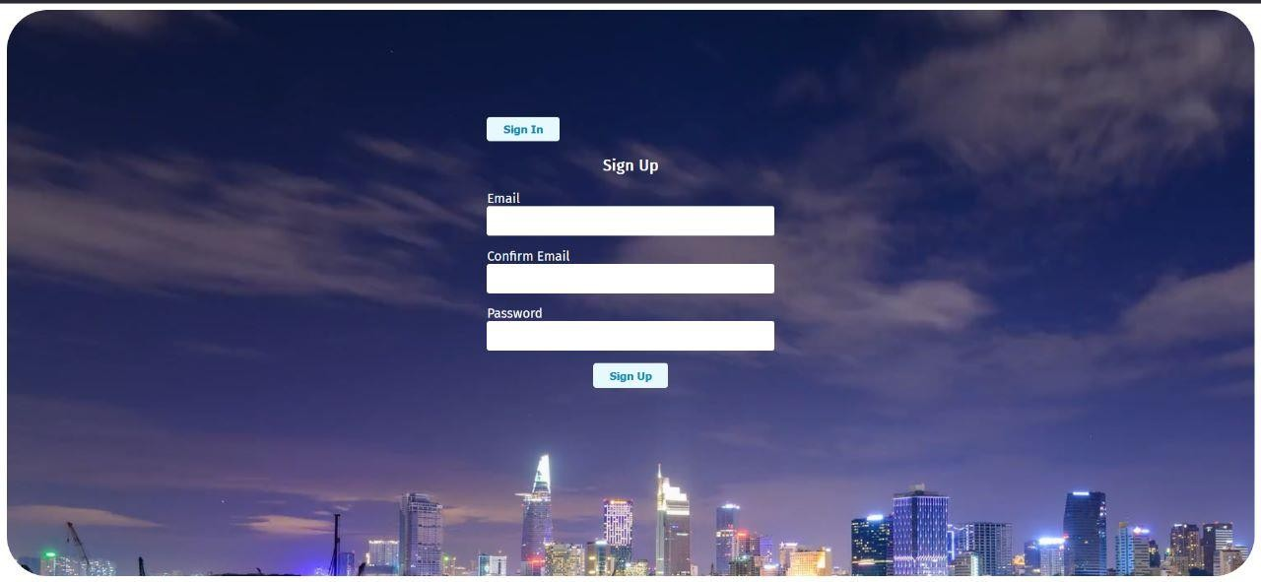
b) SIGN UP PAGE: To make the account to explore this incredible world

Slide 7
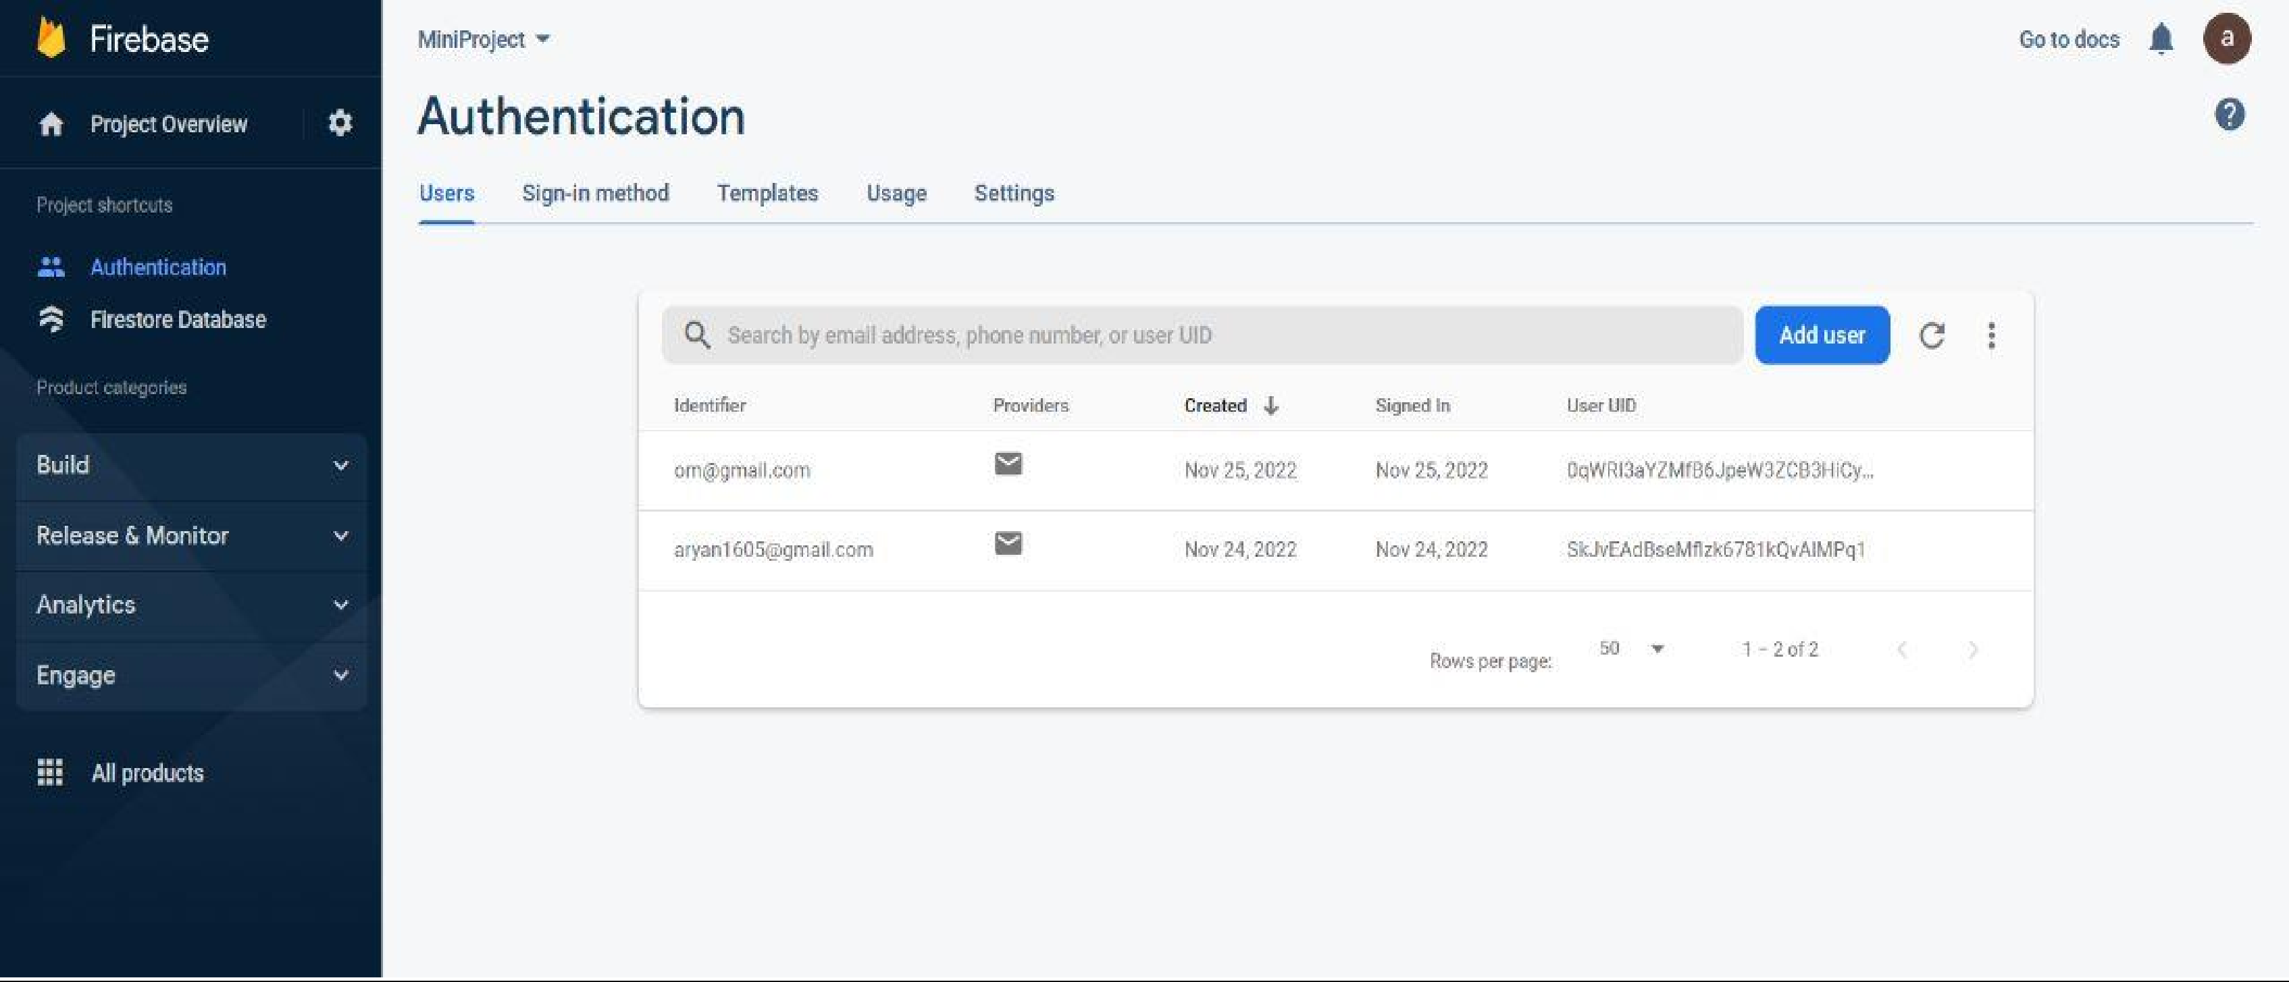
Login Page Result :

Slide 8
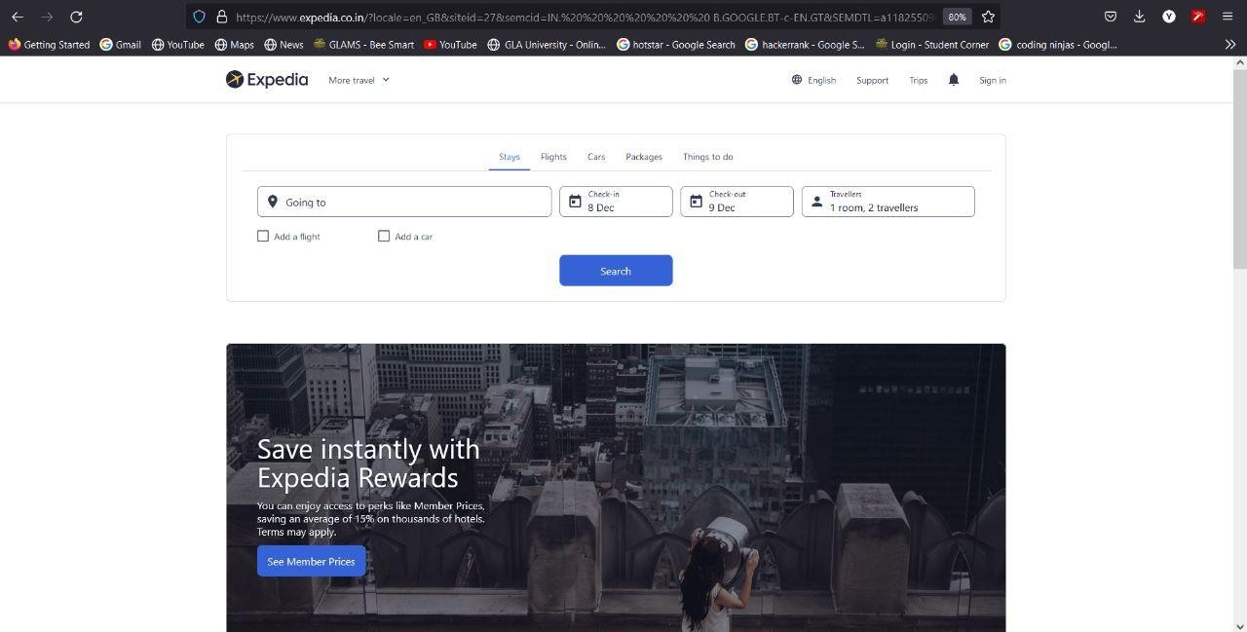
c) OUR SERVICES: Expedia

Slide 9
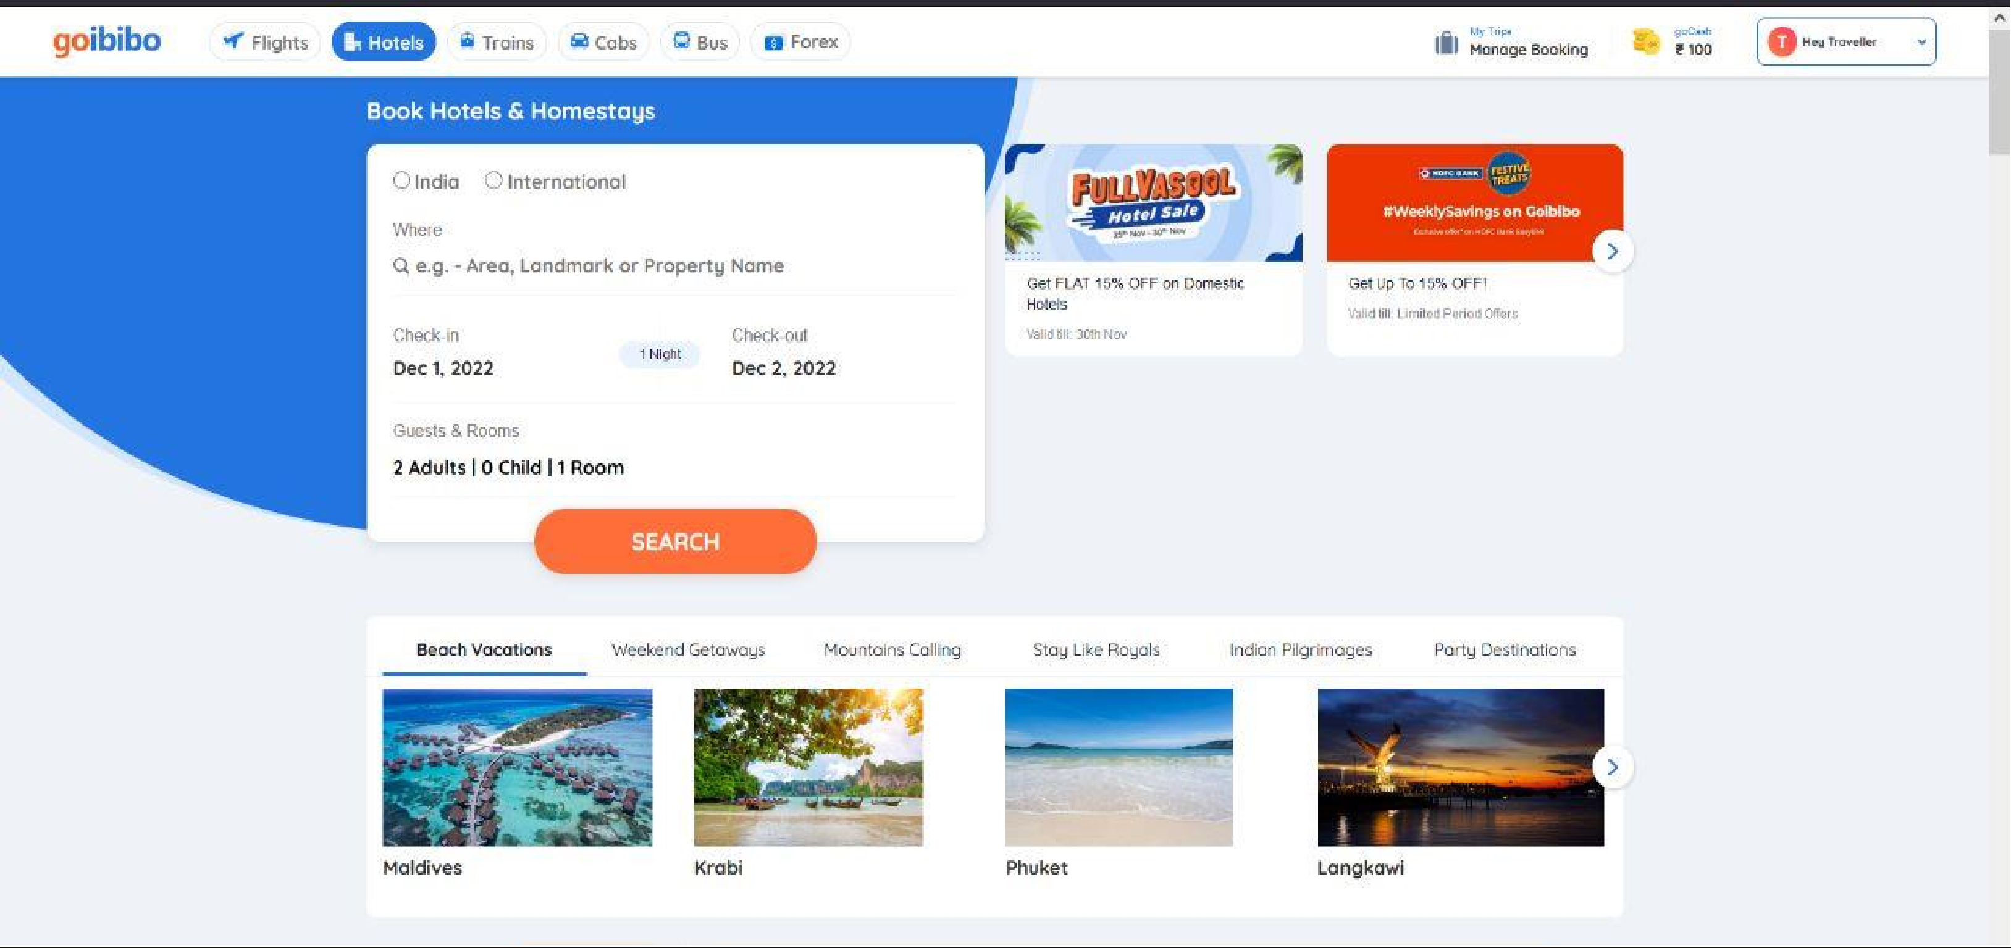
d) OUR SERVICES : Goibibo

Slide 10
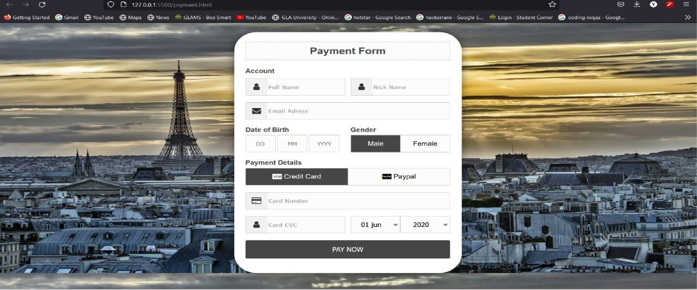
e) Payment Method:

Slide 11
f) CONTACT US:

Slide 12
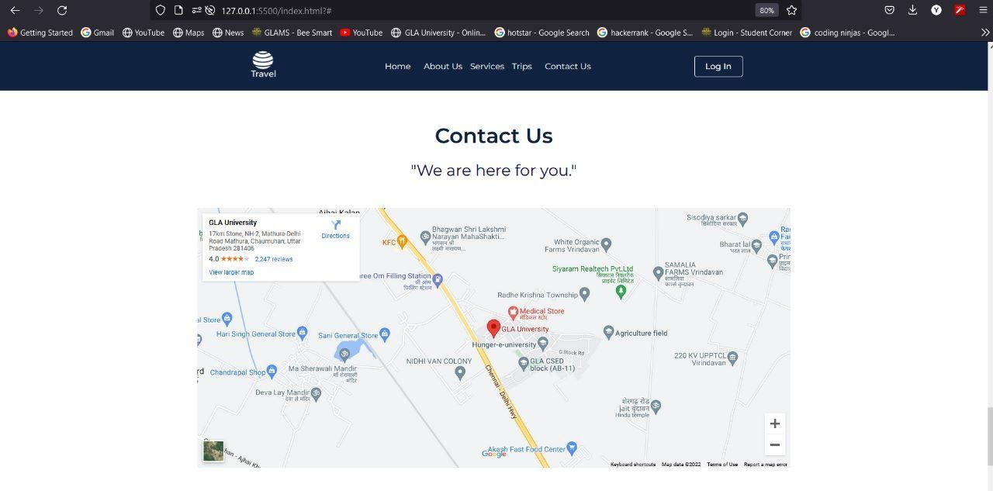

Slide 13
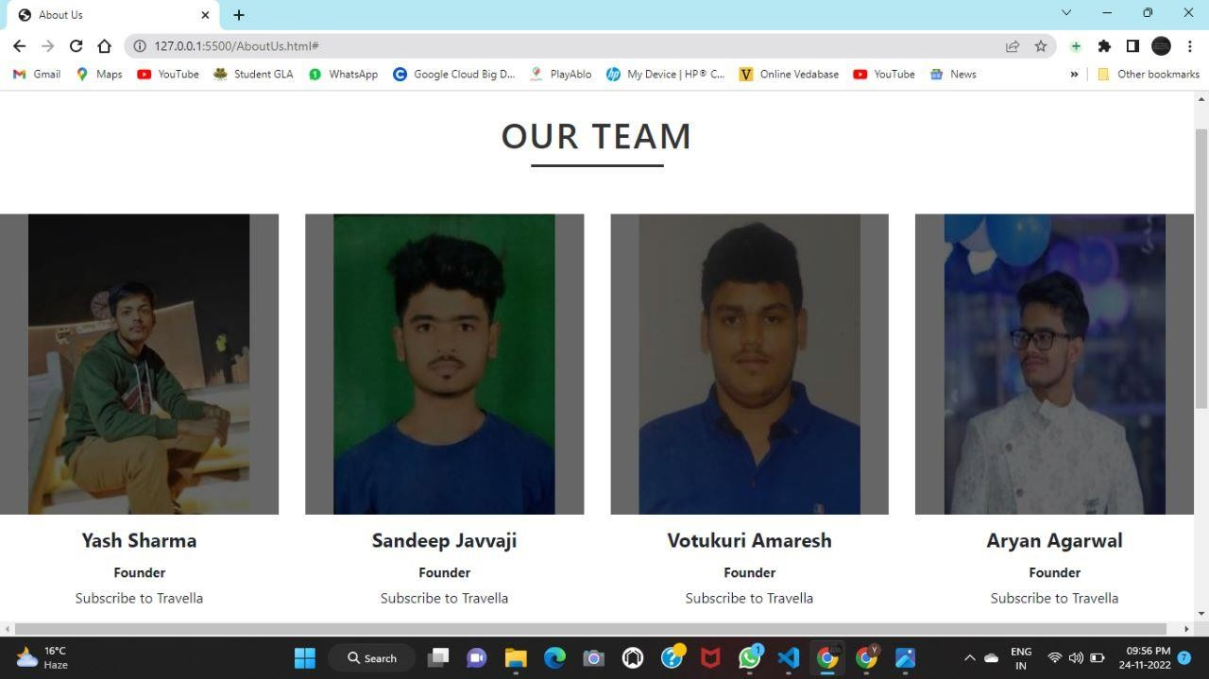
TEAM MEMBERS

Slide 14


Slide 15
Guidance:
Under the Supervision of
Mrs. Ruchi Talwar (Technical Trainer)

Slide 16


